Slide 1
StoresHub
Submitted by
Hashem Bajabaa 437015783
Anas Alzhrani 438011286
Rayan Alshanabah 438012286
Supervisor: Dr. Qaisar Abbas

Slide 2
THE TEAM
Rayan Alshanabah
Anas Alzhrani
Hashem Bajabaa - coordinator

Slide 3



TABLE OF CONTENTS
01
04
Introduction
Methodology
02
05
Problem and Solution
Website vs Web Application
03
06
Project Aims and Objectives
Comparing to others

Slide 4






TABLE OF CONTENTS
07
10
Use Case
System Architecture
08
11
Sequence Diagram
Design Patterns
09
12
Activity Diagram
Database Design

Slide 5



TABLE OF CONTENTS
13
Future work
14
Conclusion
15
Demo

Slide 6
Introduction
StoresHub
Our platform that will gather all those stores under one umbrella. Although we will be creating a fertile environment that will empower beginner Entrepreneurs to reach their customers easily in one place without needing to rent a store or build their own E-commerce website/app.

Slide 7
ABOUT THE PROJECT

Slide 8



Problems
COST
TIME
SECUITY
Solutions
StoresHub

Slide 9


AIMS
CREATE OPPORTUNITIES
PROFIT
GROWTH

Slide 10


OBJECTIVES
SECURE
ACCESSIBLE
FAST AND RELIABLE
PAYMENT
DEVELOP PLATFORM
PERFORMANCE

Slide 11
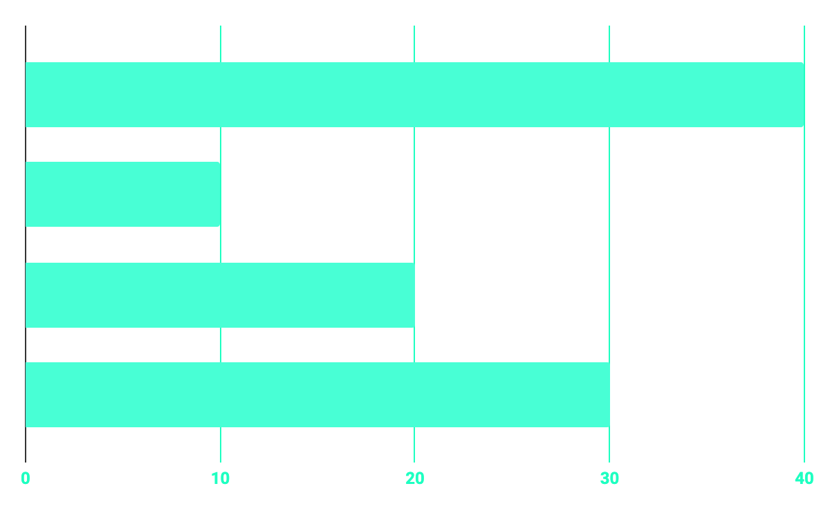
METHODOLOGY
50%
20%
HTML/CSS
10%
30%
DATABASE
JAVASCRIPT
DJANGO

Slide 12



WEBSITE
WEB APPLICATION

Slide 13


COMPETITORS
ZID
SALLA

Slide 14
HIGH LEVEL DESIGN
With Anas

Slide 15
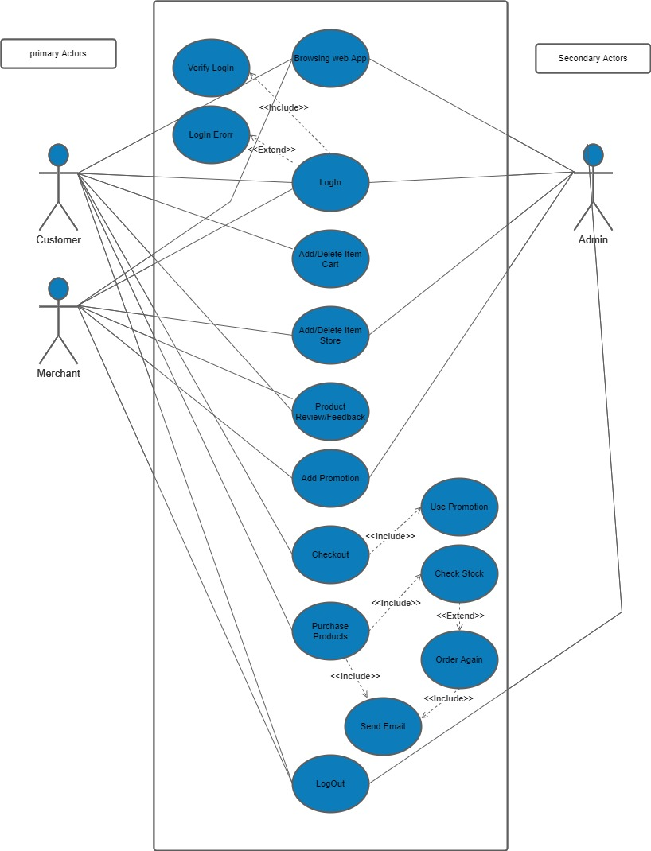
USE CASE

Slide 16
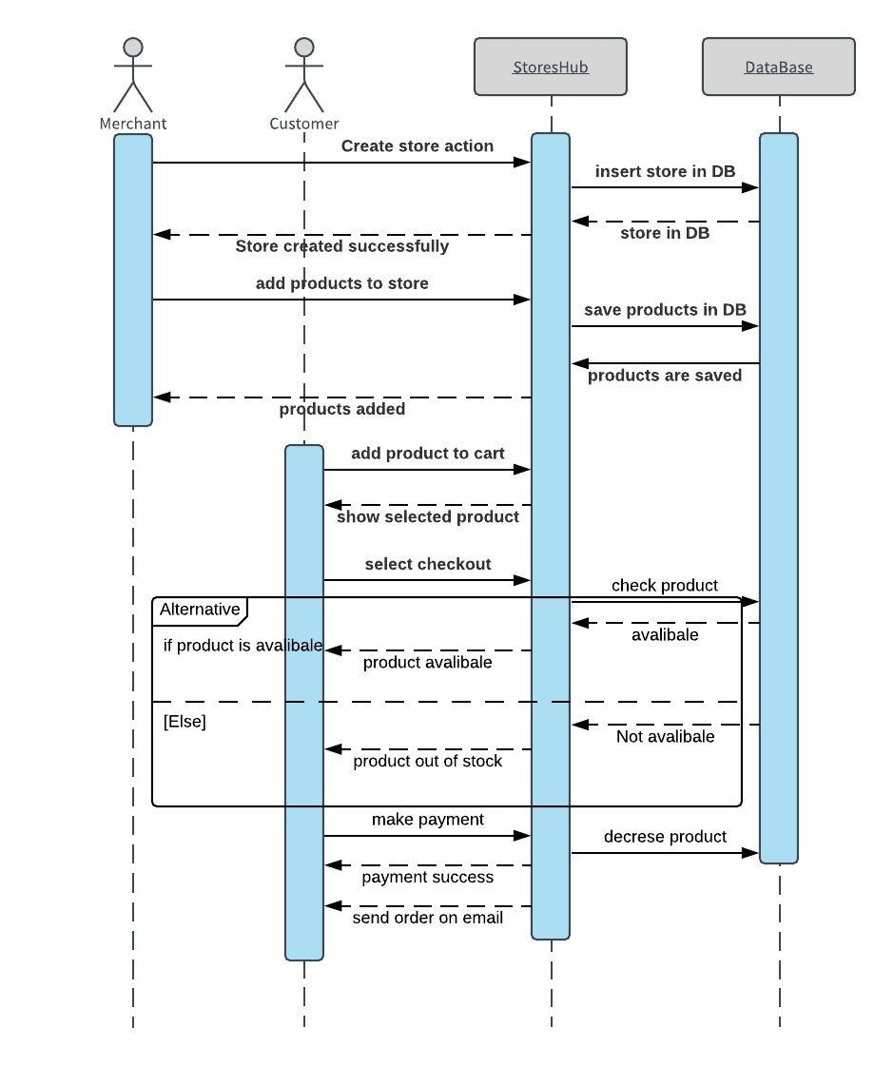
SEQUENCE DIAGRAM

Slide 17
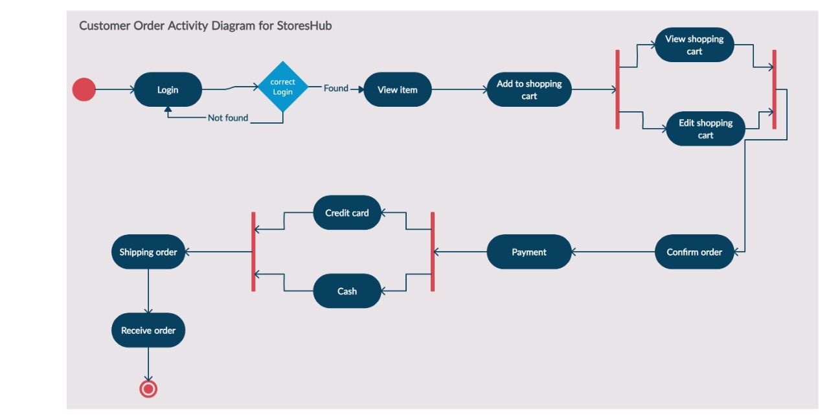
ACTIVITY DIAGRAM

Slide 18
LOW LEVEL DESIGN
With Rayan

Slide 19
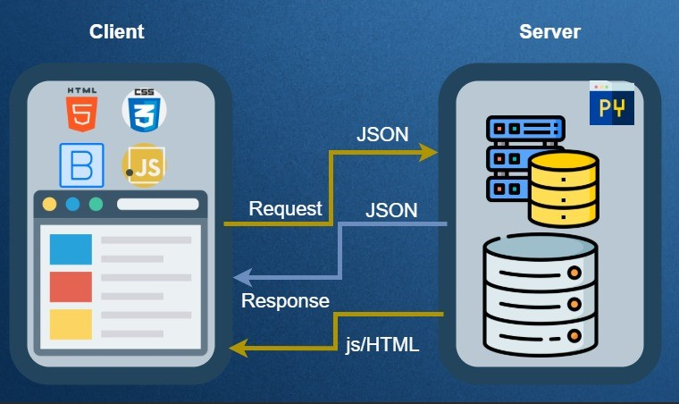
SYSTEM ARCHITECTURE

Slide 20
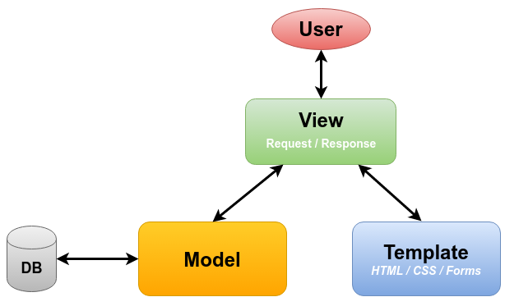
DESIGN PATTERNS

Slide 21
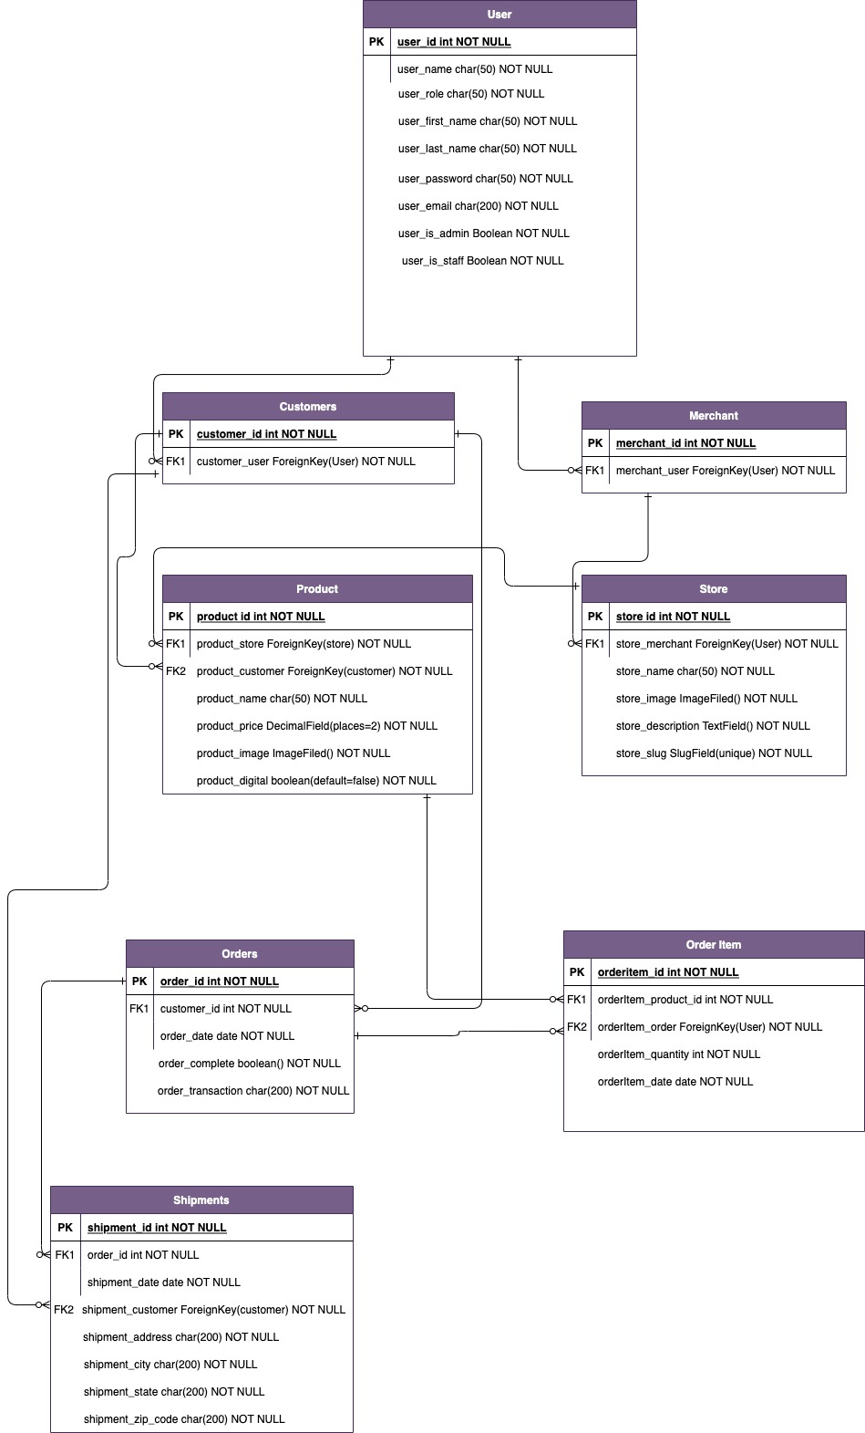
DATABASE DESIGN

Slide 22
FUTURE WORK AND CONCLUSION
With Hshem

Slide 23




FUTURE WORK
STOCKS
Delivery
SUBSCRIPTIONS
DEPLOYMENTS

Slide 24



CONCLUSION
SOLVE PROBLEMS
WORKING AS TEAM
SELF LEARNING

Slide 25


PROJECT STAGES
DESIGN
TESTING
START
FINAL
VERSION
IMPLEMENTATION
CONCLUSION AND FUTURE WORK

Slide 26

DEMO

Slide 27
CREDITS
IMAM MOHAMMAD IBN SAUD ISLAMIC UNIVERSITY
THE TEAM
DR. QAISAR ABBAS

Slide 28
THANKS!
Does anyone have any question?
addyouremail@freepik.com

